Slide 1
Building your own image factory in Azure
Using ARM, Powershell and Image Factory

Slide 2



Welcome and thank you

Slide 3







Onze Sponsoren

Slide 4
Agenda
Introduction
Accessing the Virsoft lab environment
Prepping the lab VM
Deploying an Azure VM using ARM
Prepping the Azure VM
Installing Image Factory
Configuring Image Factory
Creating your first automated reference image using Image Factory
Tips and Tricks

Slide 5
Introduction
Arjan Bakker
co-owner of ConsulteQ (f.k.a. L2Vision)
Just an IT guy that happens to like automating stuff with PowerShell
@ArjanBakr
arjan@consulteq.nl

Slide 6
Accessing the Virsoft lab environment
Go to: https://labs3.virsoft.net/wmug/1b?user=<enter your user number>

Slide 7
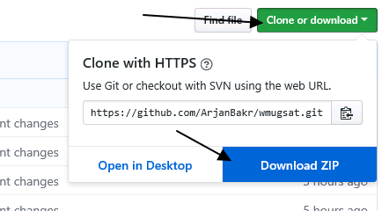
Prepping the lab VM
Go to: https://github.com/ArjanBakr/wmugsat
Clone the repo by selecting
Clone or download
Download ZIP
Download and save the file to the default location
After download, unzip the file in the default location
On your own laptop go to: https://github.com/ArjanBakr/wmugsat/blob/master/Docs/WMUG%20Saturday%20-%20ImageBuilder.docx or use this short URL: https://bit.ly/2Kbshmx
Download and open the Word document.
Follow the instructions to complete this lab
Password for Student:
AzurePa$$w0rd

Slide 8
Start the lab
Follow the instuctions in the downloaded LAB document

Slide 9
Tips & Trick
Use the WSUS maintenance script to keep your WSUS server healthy
Use the SetupComplete.cmd option to run scripts during the deployment of the ref image
Use that to determine the platform where the image is being deployed
Adjust the image accordingly
Convert the created WIM file to:
VHD
VHDX
Convert the VHD file to VMDK and use that to create an OVF

